Slide 1
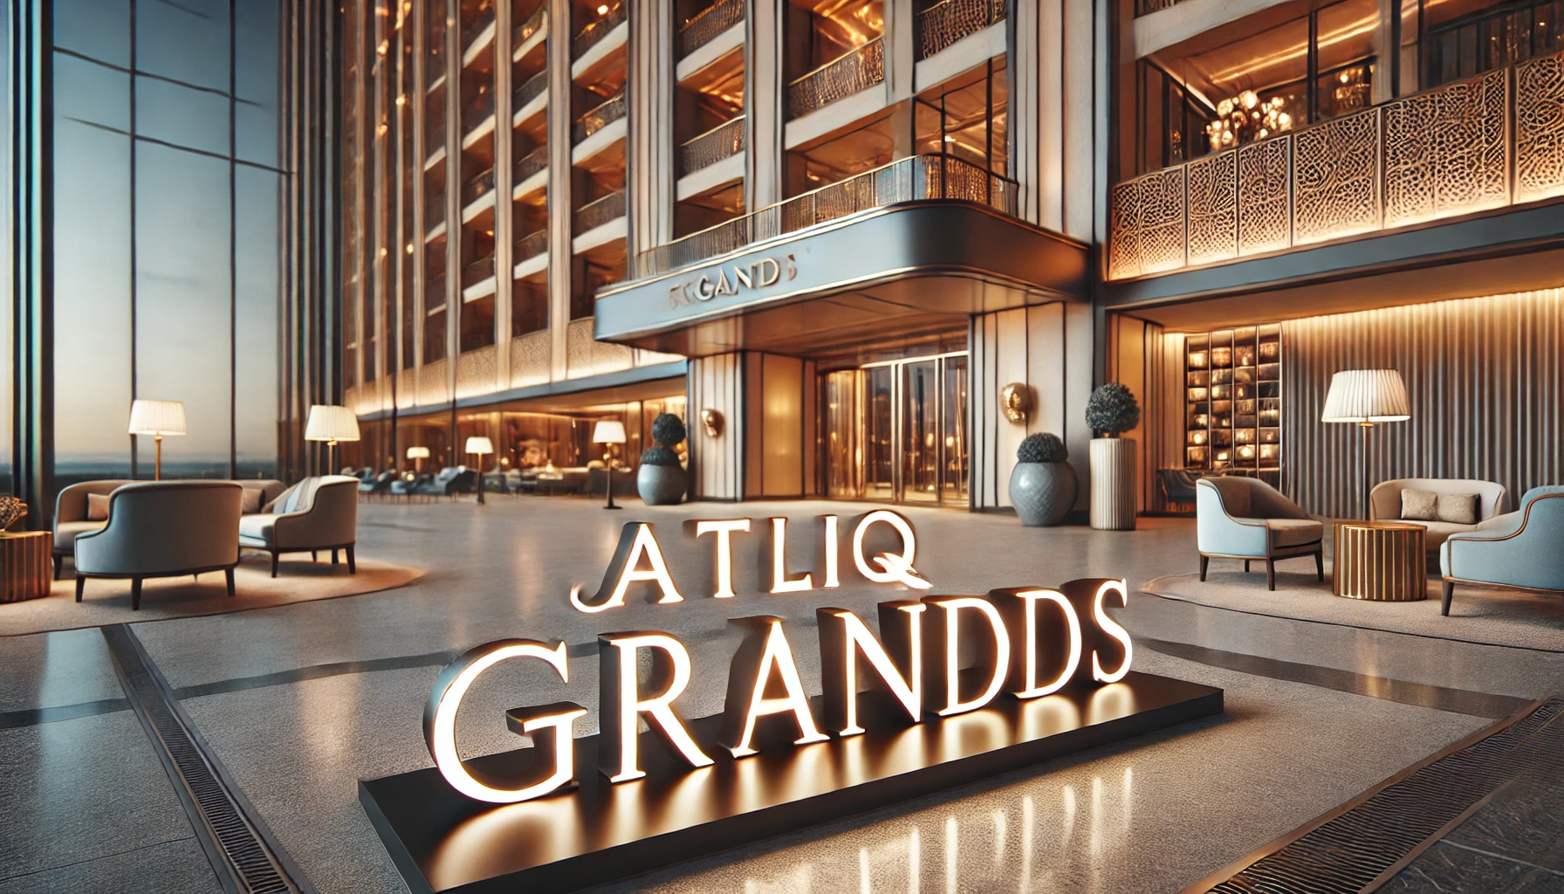

Slide 2
Business Intelligence for AtliQ Grands -Reviving Growth with Data-Driven Insights

Slide 3
AtliQ Grands owns multiple five-star hotels across India.
They have been in the hospitality industry for the past 20 years.
Due to strategic moves from other competitors and ineffective decision-making in management, AtliQ Grands are losing its market share and revenue in the luxury/business hotels category.
As a strategic move, the managing director of AtliQ Grands wanted to incorporate “Business and Data Intelligence” to regain their market share and revenue.

Slide 4
Property Name
Atliq Bay
Atliq Blu
Atliq City
Atliq Exotica
Atliq Grands
Atliq Palace
Atliq Seasons
Room Class
Elite
Premium
Presidential
Standard
Data Given :
Booking platform
Booking Status
Successful Bookings
Capacity
Ratings given
Revenue generated
Revenue realized.
City
Bangalore
Delhi
Hyderabad
Mumbai
Category
Business
Luxury

Slide 5
Key Metrics.
Revenue: Total revenue realized.
Occupancy%: Ratio of successful bookings to total capacity.
ADR (Average Daily Rate): Ratio of revenue to rooms booked.
RevPAR: Revenue per available room.
DBRN, DSRN, and DURN: Metrics for daily booking, selling, and utilization trends.
Realisation : Potential revenue based on ADR and Occupancy.

Slide 6


Slide 7
Key Insights:
Revenue Trends:
Weekday revenue remains consistently higher (average ~95M) compared to weekends (~42M), highlighting strong business traveler demand.
Revenue dips observed in W21, W23, W26, and W30, indicating potential seasonal impacts or operational inefficiencies.
Occupancy Patterns:
Higher occupancy on weekends (average ~66%) compared to weekdays (~59%), suggesting stronger appeal to leisure travelers.
Notable occupancy drops in W21, W23, W26, and W30 across both segments, requiring further investigation into external factors (e.g., events, holidays).
ADR (Average Daily Rate) Stability:
ADR remains stable across weeks for both weekdays (~12,700K) and weekends (~12,800K), indicating effective pricing strategies.
Weekend ADR slightly higher, reflecting potential for premium pricing during leisure peak periods.

Slide 8
Key Insights:
4.Realisation % by Booking Platform:
Consistent realisation rates (~70%) across platforms, with Logtrip (70.57%) and Journey (70.54%) performing slightly better.
Tripster (69.80%) and Makeyourtrip (69.92%) show marginally lower realisation, indicating opportunities to improve revenue strategies through these channels.
5.Booking Platform Performance:
Highest ADR observed via Tripster (12,778K) and Direct Offline (12,793K) bookings, suggesting these channels attract high-paying customers.
Direct Online bookings have the lowest ADR (12,638K), signaling the need to reassess pricing strategies for online channels.
6.Overall Performance:
Weekend RevPAR (7,972K) outperforms weekdays (7,083K) despite lower revenue, driven by higher occupancy rates.
Average Rating of 3.62 indicates room for improvement in customer satisfaction to enhance retention and pricing power.

Slide 9
🚀 Recommendations:
Revenue Optimization:
Focus on underperforming properties (Atliq Grands, Blu): Revamp marketing strategies, introduce seasonal offers, and improve customer experience.
Capitalize on high-performing cities (Mumbai, Delhi): Target business travelers with premium packages.
RevPAR Improvement:
Leverage weekend trends: Leverage the success of high ADR weekends (W28, W31) by replicating pricing models during similar demand periods.
Dynamic pricing models Increase ADR without impacting occupancy by bundling services like free breakfast, spa discounts, or early check-ins.
Flexible Weekday Rates: Introduce mid-week promotional offers to attract more corporate clients and remote workers.
Occupancy Boost Strategies:
Address low occupancy properties (Atliq Seasons): Run loyalty programs, corporate tie-ups, and flash sales to attract more guests.
Bangalore focus: Given the decline, analyze local events, business travel trends, and customer feedback for targeted improvements.
ADR Management:
Enhance luxury offerings where ADR growth is slow (e.g., Atliq Blu).
Promote premium rooms on high-demand days (weekends) to maximize ADR.
5. Realisation Efficiency:
Operational cost audits at Atliq Grands and Blu to identify inefficiencies.
Incentivize direct bookings to reduce commission costs and improve realisation.

Slide 10
6. Segment-Specific Strategies:
Business segment success: Expand corporate partnerships and MICE (Meetings, Incentives, Conferences, Exhibitions) offerings.
Luxury segment lag: Enhance premium services and personalized guest experiences to attract high-net-worth individuals.
7. Seasonal Campaigns:
Target festive and holiday seasons with tailored packages to boost both occupancy and revenue.
8. Dynamic Pricing Strategy:
Increase Weekend ADR: Adjust pricing to capitalize on strong weekend demand without significantly impacting occupancy.
Flexible Weekday Rates: Introduce mid-week promotional offers to attract more corporate clients and remote workers.
9. Targeted Marketing:
Weekend Focus: Promote packages for families, couples, and leisure travelers. Leverage local events, festivals, and activities.
Weekday Boost: Target business travelers with corporate partnerships, loyalty programs, and discounted long-stay packages.
10. Operational Efficiency:
Staff Allocation: Align staffing and resources with occupancy trends to manage costs effectively during low-demand weekdays.
Weekend Experience: Enhance weekend offerings with value-added services like brunches, spa packages, or late check-out to increase guest satisfaction and revenue

Slide 11
11. Conduct Detailed Feedback Analysis:
Breakdown Ratings: Analyze reviews by property, city, and customer segments to identify patterns in low scores.
Focus on Pain Points: Prioritize addressing recurring issues like room quality, service delays, or cleanliness.
12. Enhance Customer Experience:
Staff Training: Improve customer service skills to ensure consistent, high-quality guest interactions.
Personalized Services: Offer tailored experiences based on guest preferences, especially for repeat customers.
13. Improve Response Strategy:
Engage with Feedback: Respond proactively to negative reviews, showing commitment to improvement.
Real-Time Issue Resolution: Implement systems to capture guest complaints during their stay, allowing immediate resolution.
14. Boost Positive Reviews:
Encourage Happy Guests: Request satisfied guests to leave reviews, as positive feedback can help balance occasional negative ratings.
Loyalty Incentives: Offer small rewards for detailed feedback to better understand customer expectations.
15. Optimize Occupancy Rates:
Weekday Strategies: Improve corporate partnerships, business travel packages, and flexible booking options to fill weekday gaps.
Weekend Campaigns: Introduce weekend getaway packages, family discounts, and local events to maximize occupancy, especially during weak weekends.

Slide 12
16. Investigate Performance Drivers:
Root Cause Analysis: Conduct deep dives into underperforming weeks to identify causes—whether seasonal demand shifts, events, or operational issues.
Feedback Loops: Gather guest feedback during both high and low-performing weeks to understand satisfaction trends impacting occupancy and revenue.
17. Enhance Underperforming Channels:
Tripster: Reassess pricing strategies to improve conversion. Consider offering exclusive discounts or value-added services to enhance realisation % without compromising ADR.
Makeyourtrip: Optimize promotional campaigns and booking processes to boost realisation %, focusing on customer experience improvements.
18. Leverage High-Performing Platforms:
Logtrip & Journey: Allocate more marketing budget to these platforms, as they offer both strong realisation rates and competitive ADRs. Strengthen partnerships to secure more prime listings or deals.
19. Direct Booking Strategy:
Direct Online Optimization: Improve website UX, introduce loyalty programs, and streamline the booking process to boost ADR while maintaining strong realisation %.
Offline Bookings: Maintain the personal touch that drives higher ADR, possibly through corporate tie-ups, exclusive packages, or concierge services.
20. Monitor & Adjust in Real-Time:
Implement real-time dashboards to track fluctuations promptly, allowing for quick marketing campaigns or rate adjustments based on live data.

Slide 13
Thank you

